Slide 1

Bank Account Management System

Slide 2
Why we use bank account management system?
A Bank Account Management System is used to efficiently manage and monitor customers’ banking activities. It helps banks and users keep track of deposits, withdrawals, account balances, and transaction histories in a secure and organized way. The system reduces manual errors, speeds up banking processes, and enhances customer service by providing quick access to account information. It also ensures data security, regulatory compliance, and real-time financial reporting.
Uses of a Bank Account Management System:
Account Management
Transaction Tracking
Balance Monitoring
Security and Fraud Detection
Report Generation
Customer Service Support
Automation of Routine Tasks
Regulatory Compliance

Slide 3
Link for GitHub Repository
https://github.com/Kush1401/Bank-Account-Management-System

Slide 4
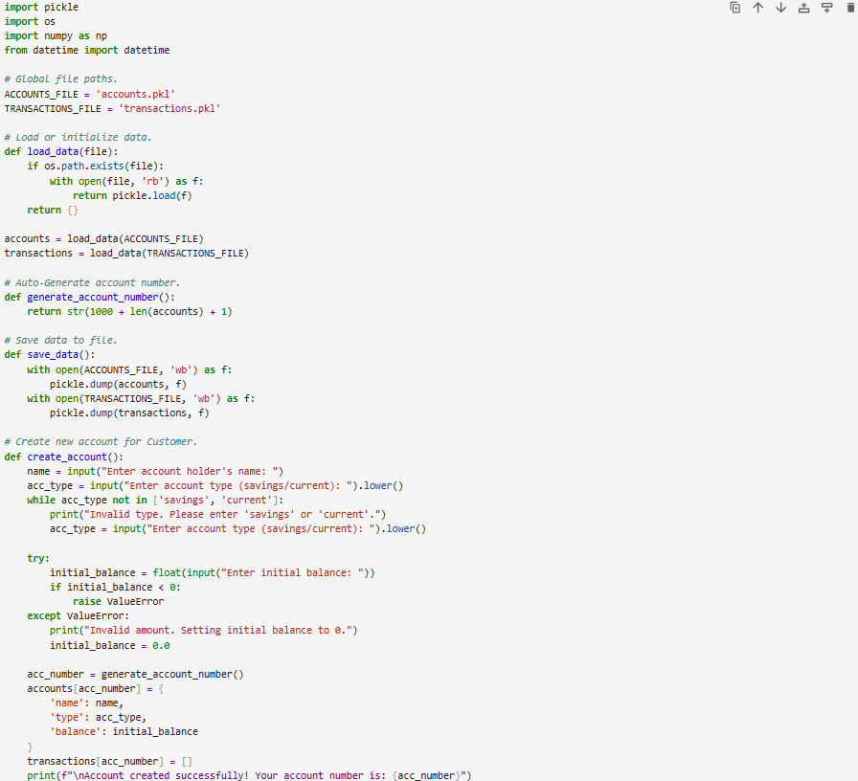
Code for Bank Account Management system

Slide 5
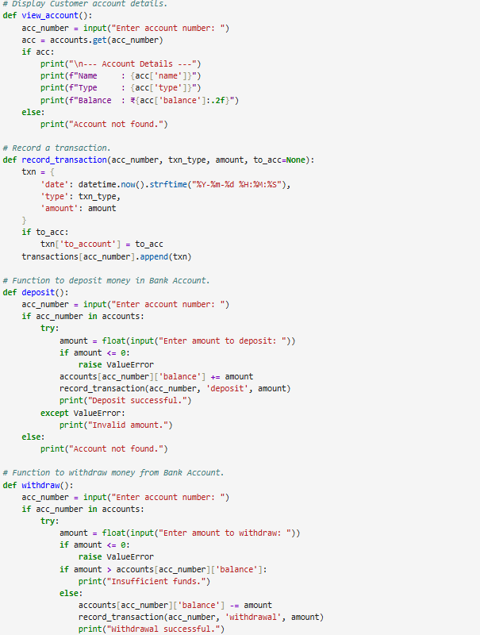
To be continued

Slide 6
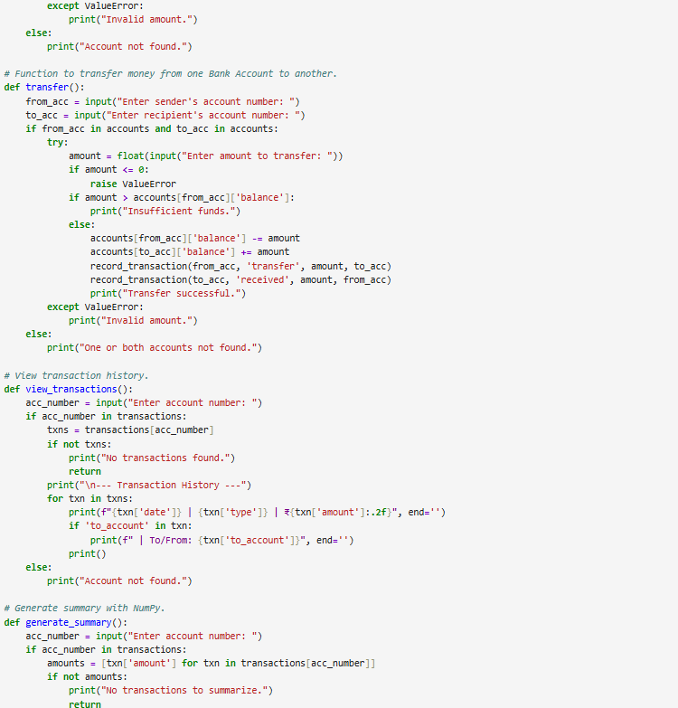
To be continued

Slide 7
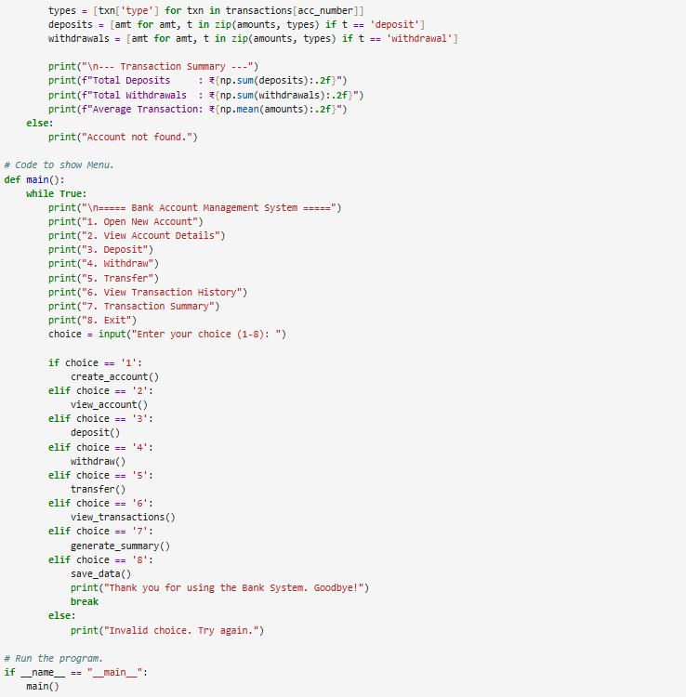
To be continued

Slide 8
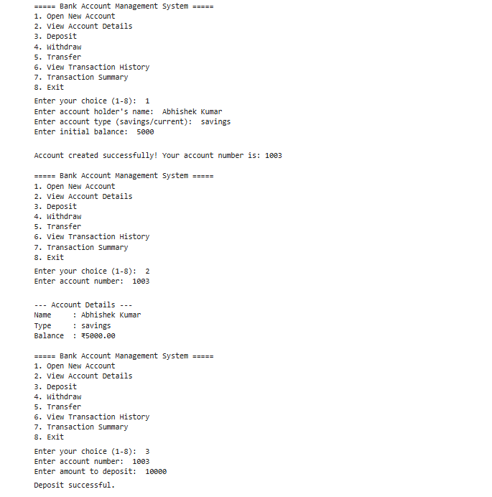
Sample TEST CASE

Slide 9
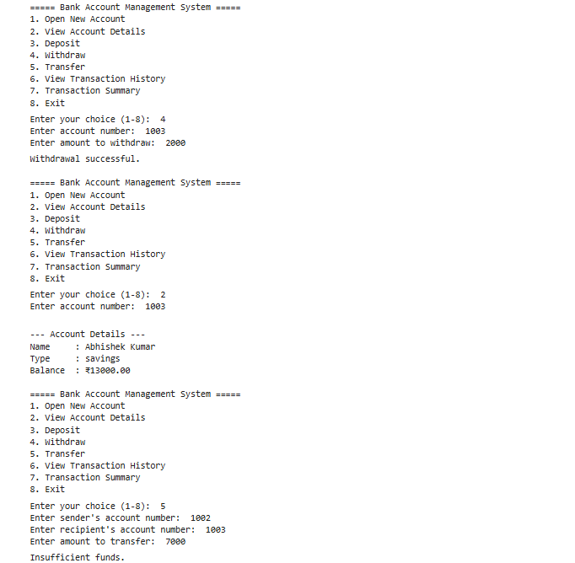
TO BE CONTINUED

Slide 10
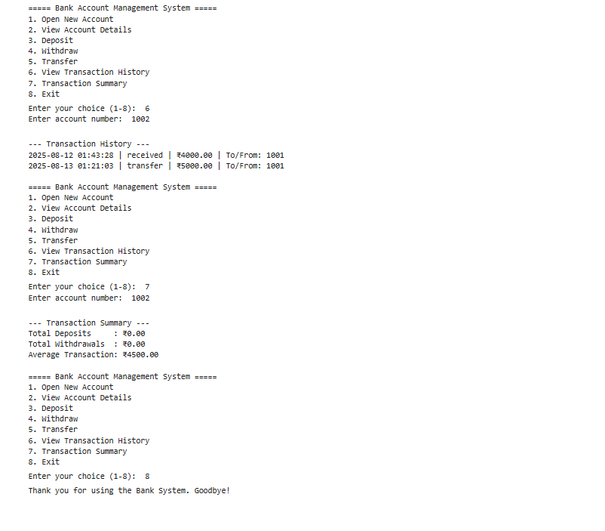
TO BE CONTINUED

Slide 11

THANK YOU
Presented By: Kushagra

